Slide 1
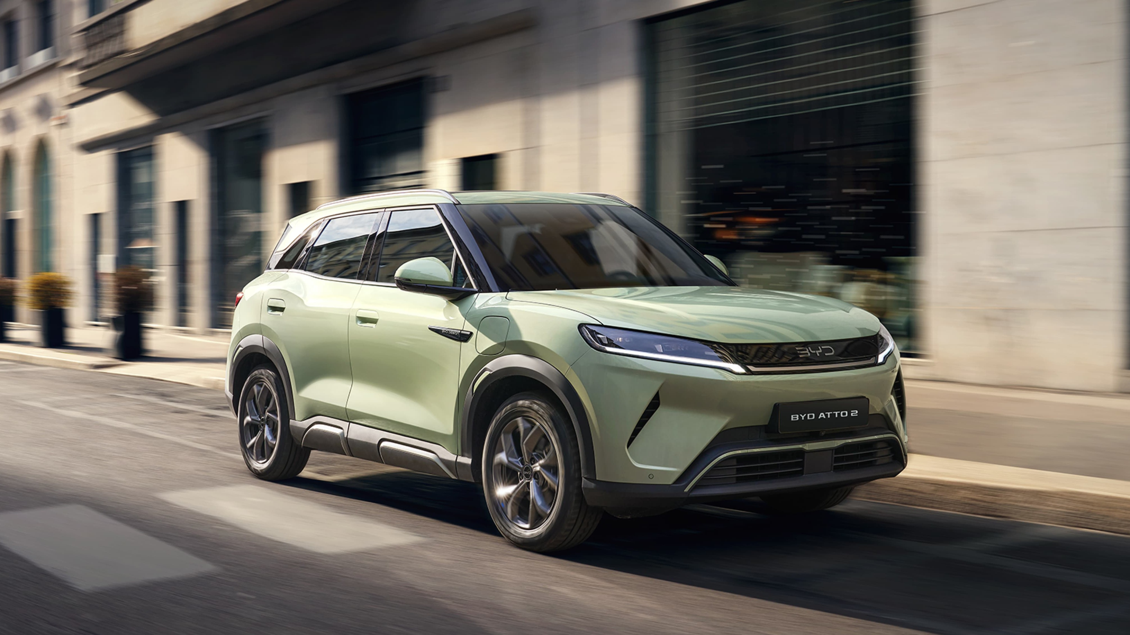


Slide 2
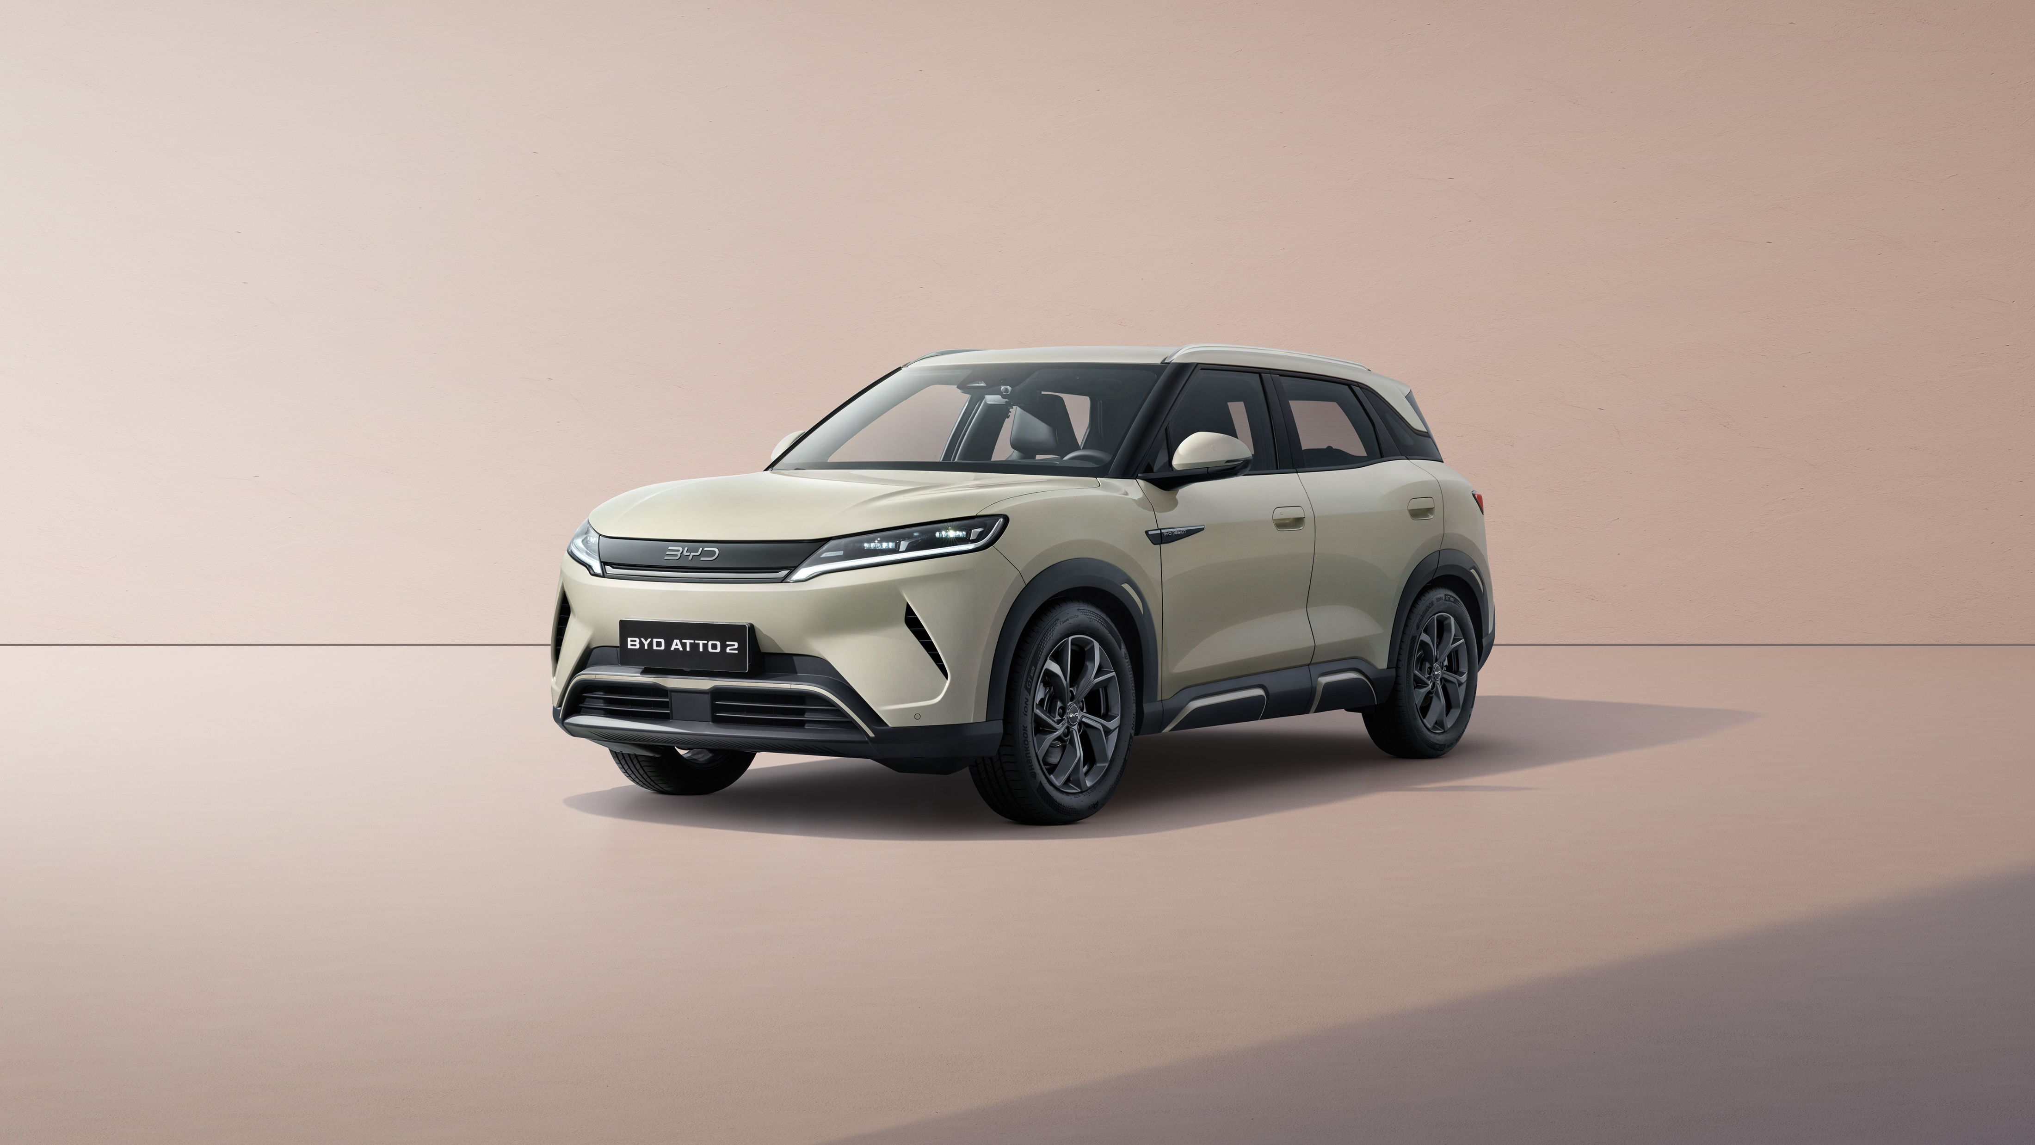
New generation urban electric vehicle
BYD ATTO 2 adopts BYD's signature "Dragon Face" design language, created by Global Design Director; Mr. Wolfgang Egger. The short protruding body kit at the front and rear of the car and the strong curves on the body create a sporty appearance, while the sturdy exterior emphasizes strength and durability.

Slide 3
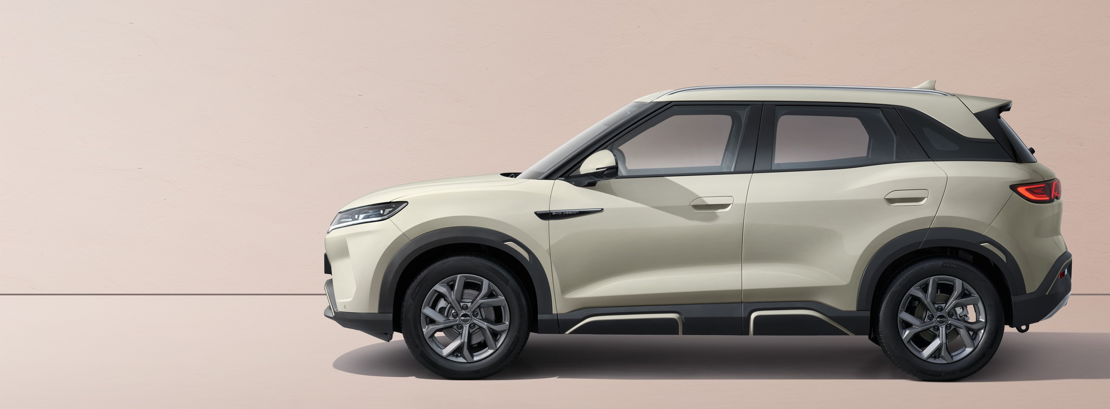
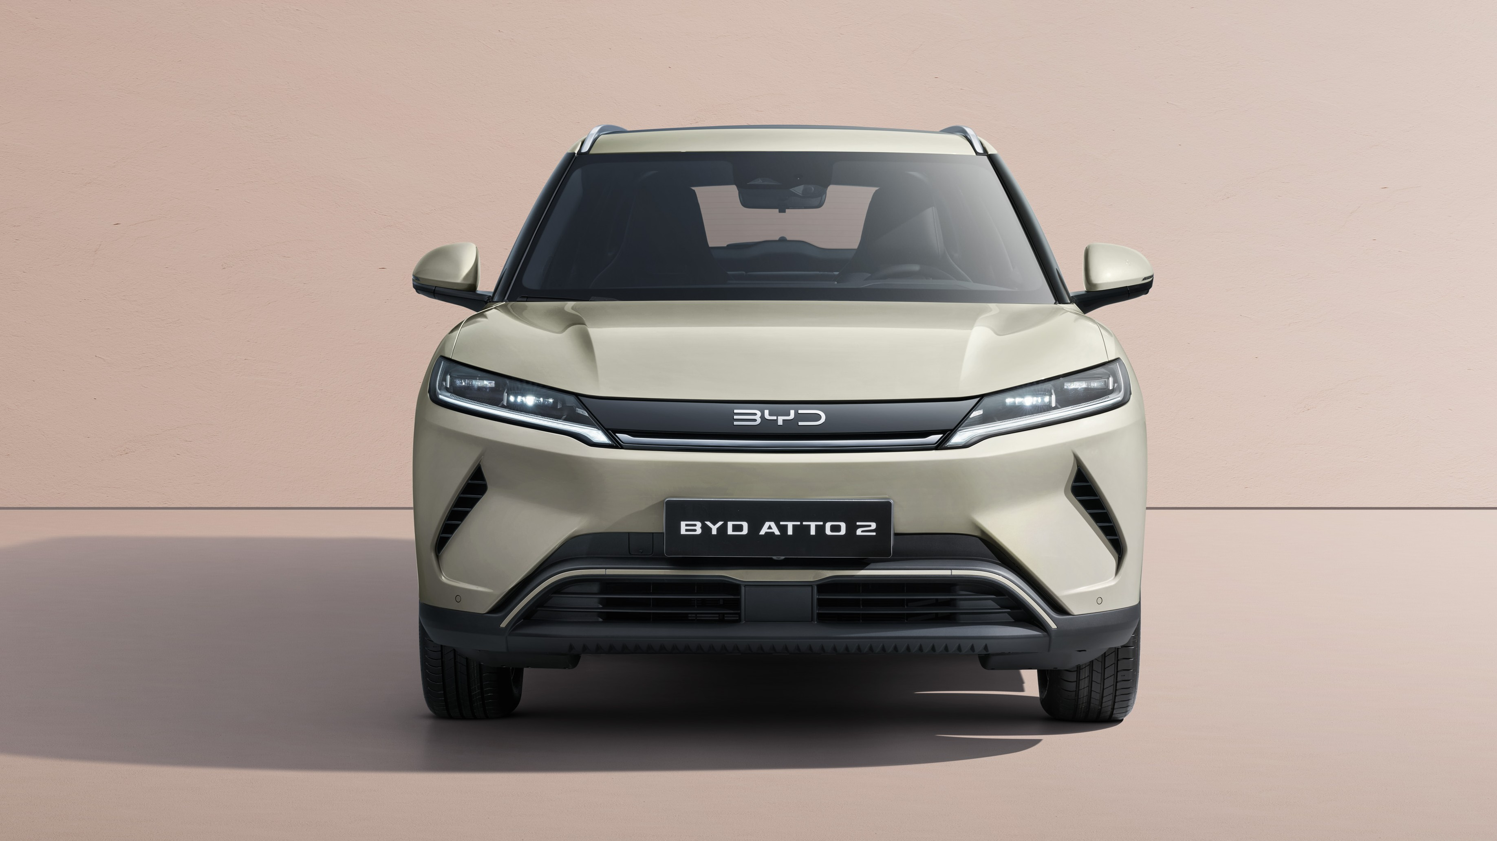
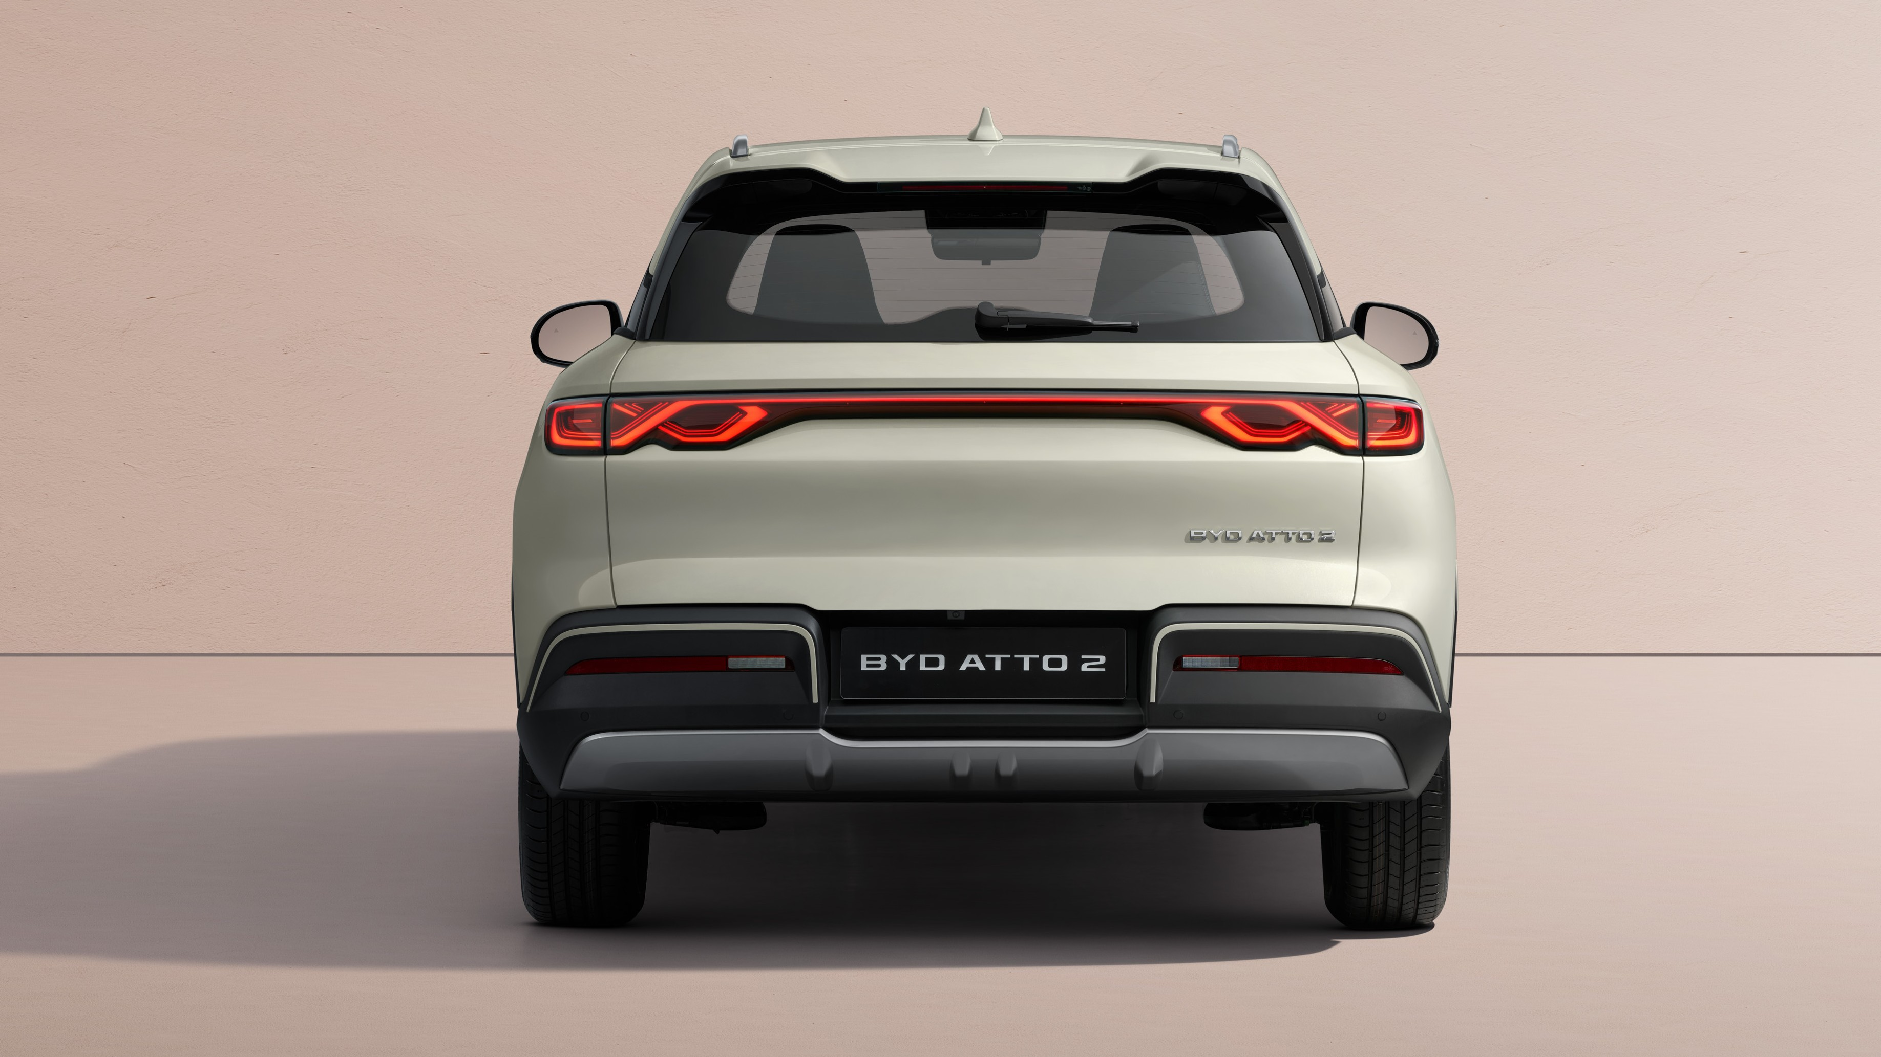
A compact electric SUV with a striking exterior
The BYD ATTO 2 adopts the family design language of the dragon face, designed by BYD's Global Design Director, Wolfgang Egger. Short overhangs and powerful curves on the body surface create a sporty look, while the robust exterior emphasizes strength and durability.
“Lighting up your journey”
Sharp LED headlights are paired with distinctive daytime-running lights to optimize visibility and safety, illuminating your journey ahead
The continuous tail-light design features the recognizable symbol of a Möbius ring, bringing endless luck for the driver and all passengers.

Slide 4
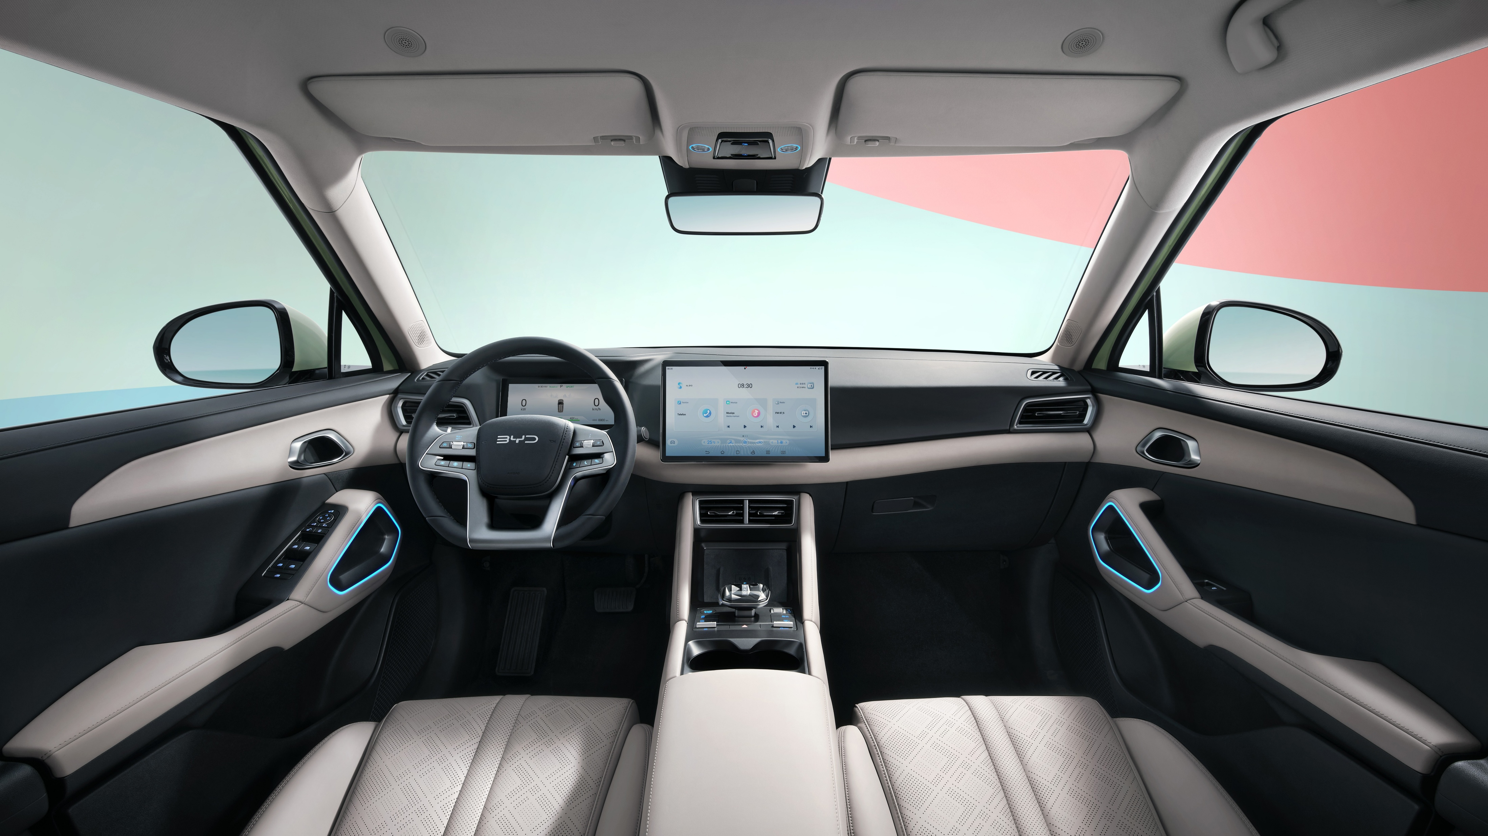
High Quality Material
The interior of the BYD ATTO 2 is crafted with sleek, eco-friendly vegan leather seats and high-quality materials throughout the dashboard and door panels.

Slide 5
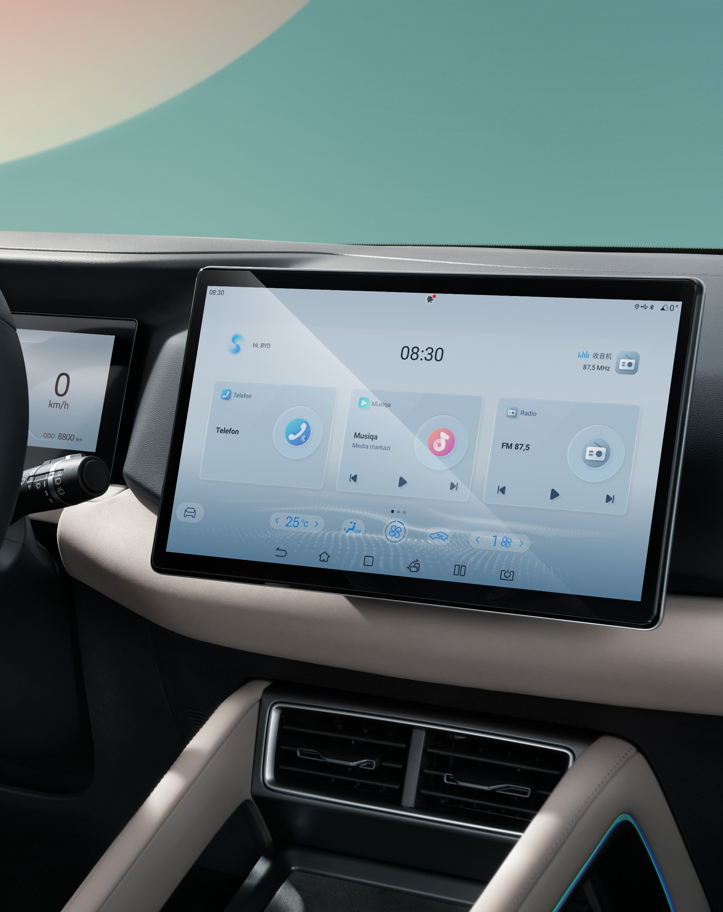
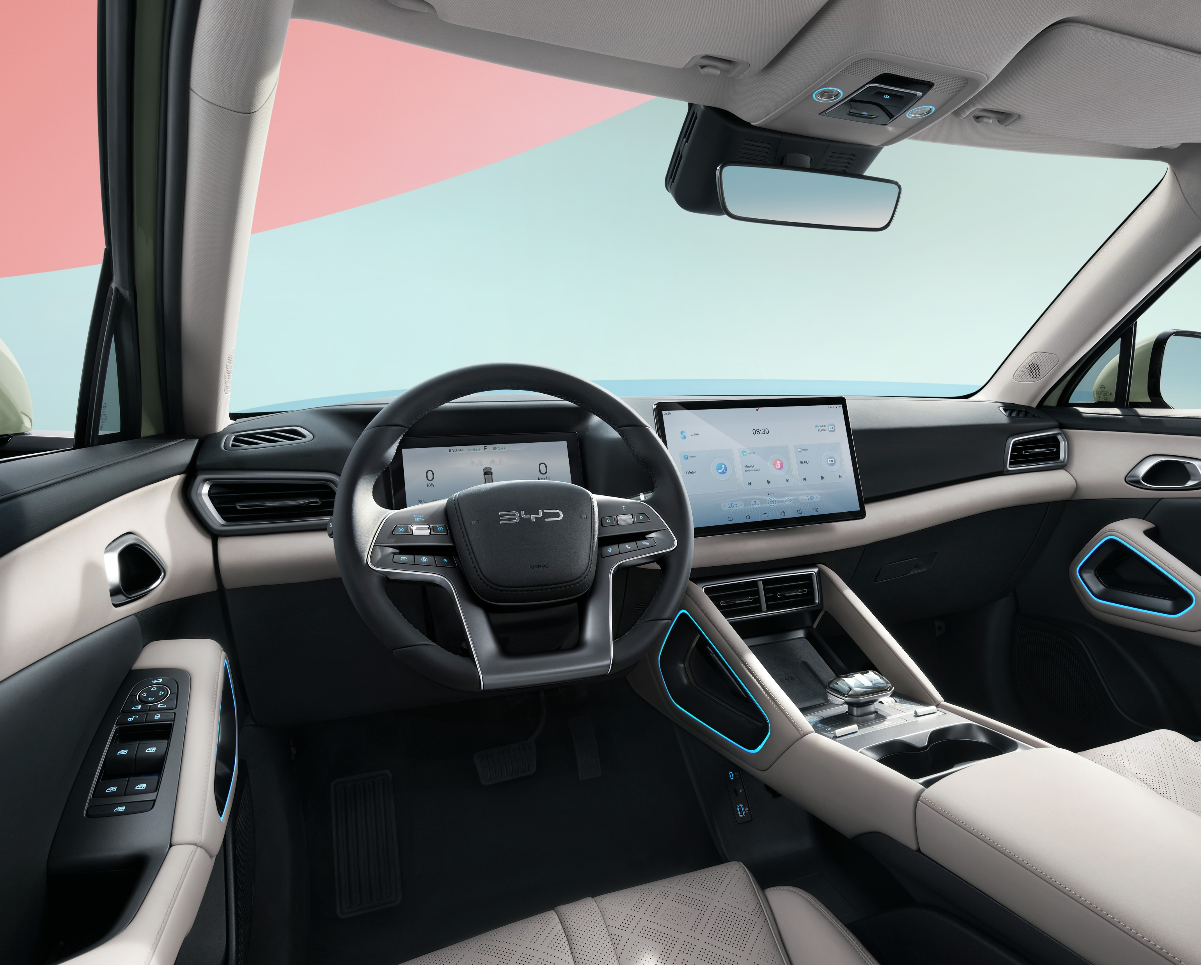
Smart screen rotates 90 degrees
This compact SUV keeps you connected and entertained on every journey thanks to its smart rotating screen, which integrates a Vietnamese virtual assistant, navigation features, apps and infotainment (wireless Apple CarPlay and Android Auto).
Ergonomic seat for comfort
on every journey
The multi-function seats provide superior comfort, with electronic adjustment to your preferred seating position. The raised driving position provides better visibility in heavy traffic, making city driving safer and more manageable.

Slide 6
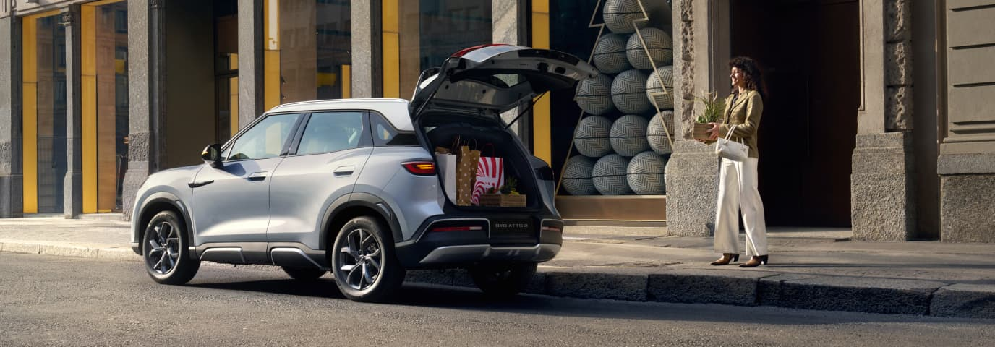
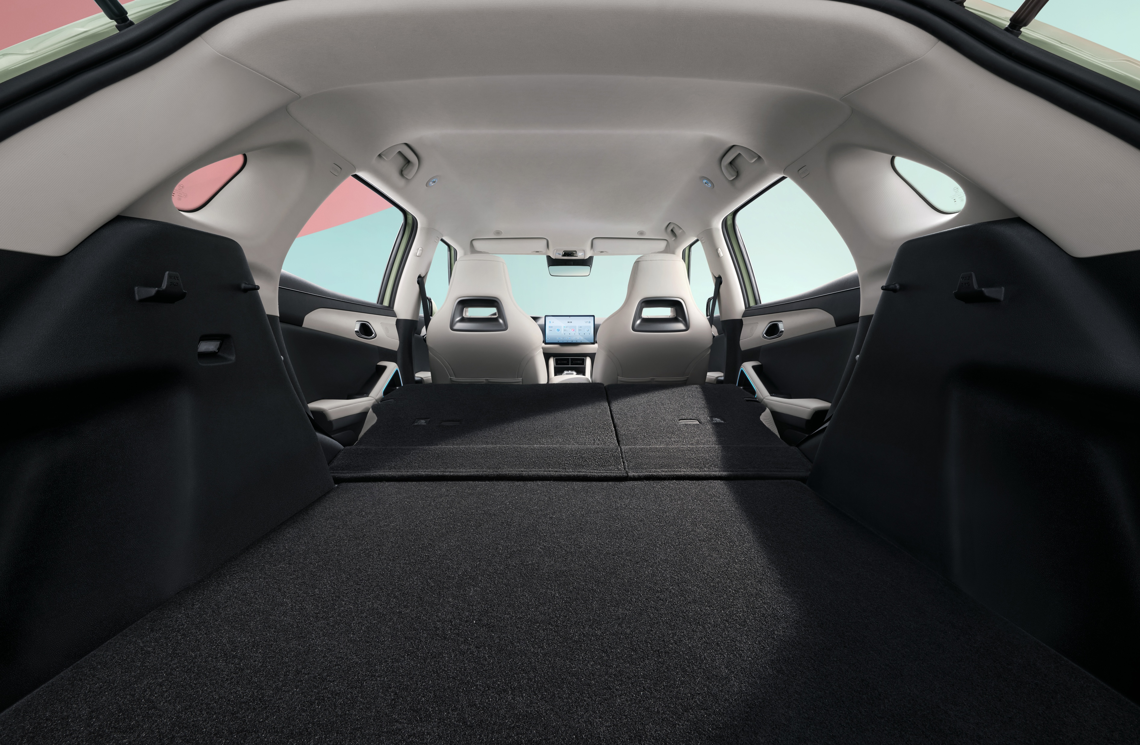
Smart storage for extra luggage space
This compact SUV has a boot capacity of 400 liters, which can be expanded to 1,340 liters when the rear seats are folded down. Smart in-cabin storage ensures that there’s always space for essentials, from suitcases to shopping bags.

Slide 7
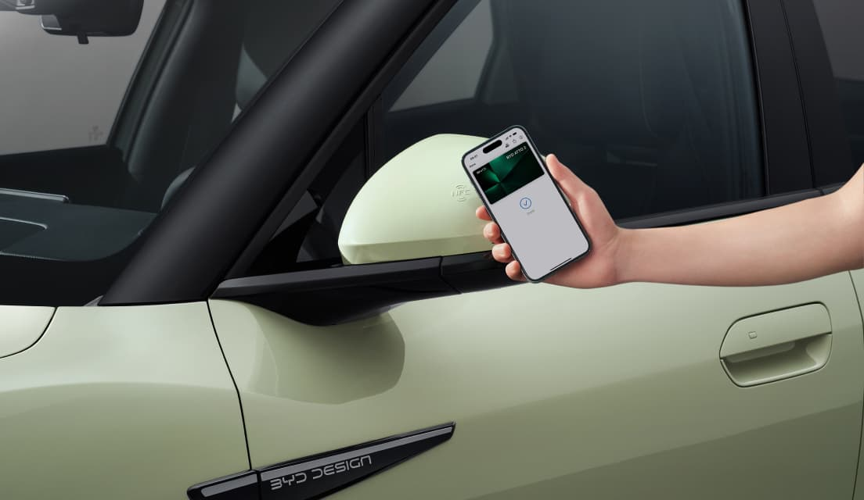
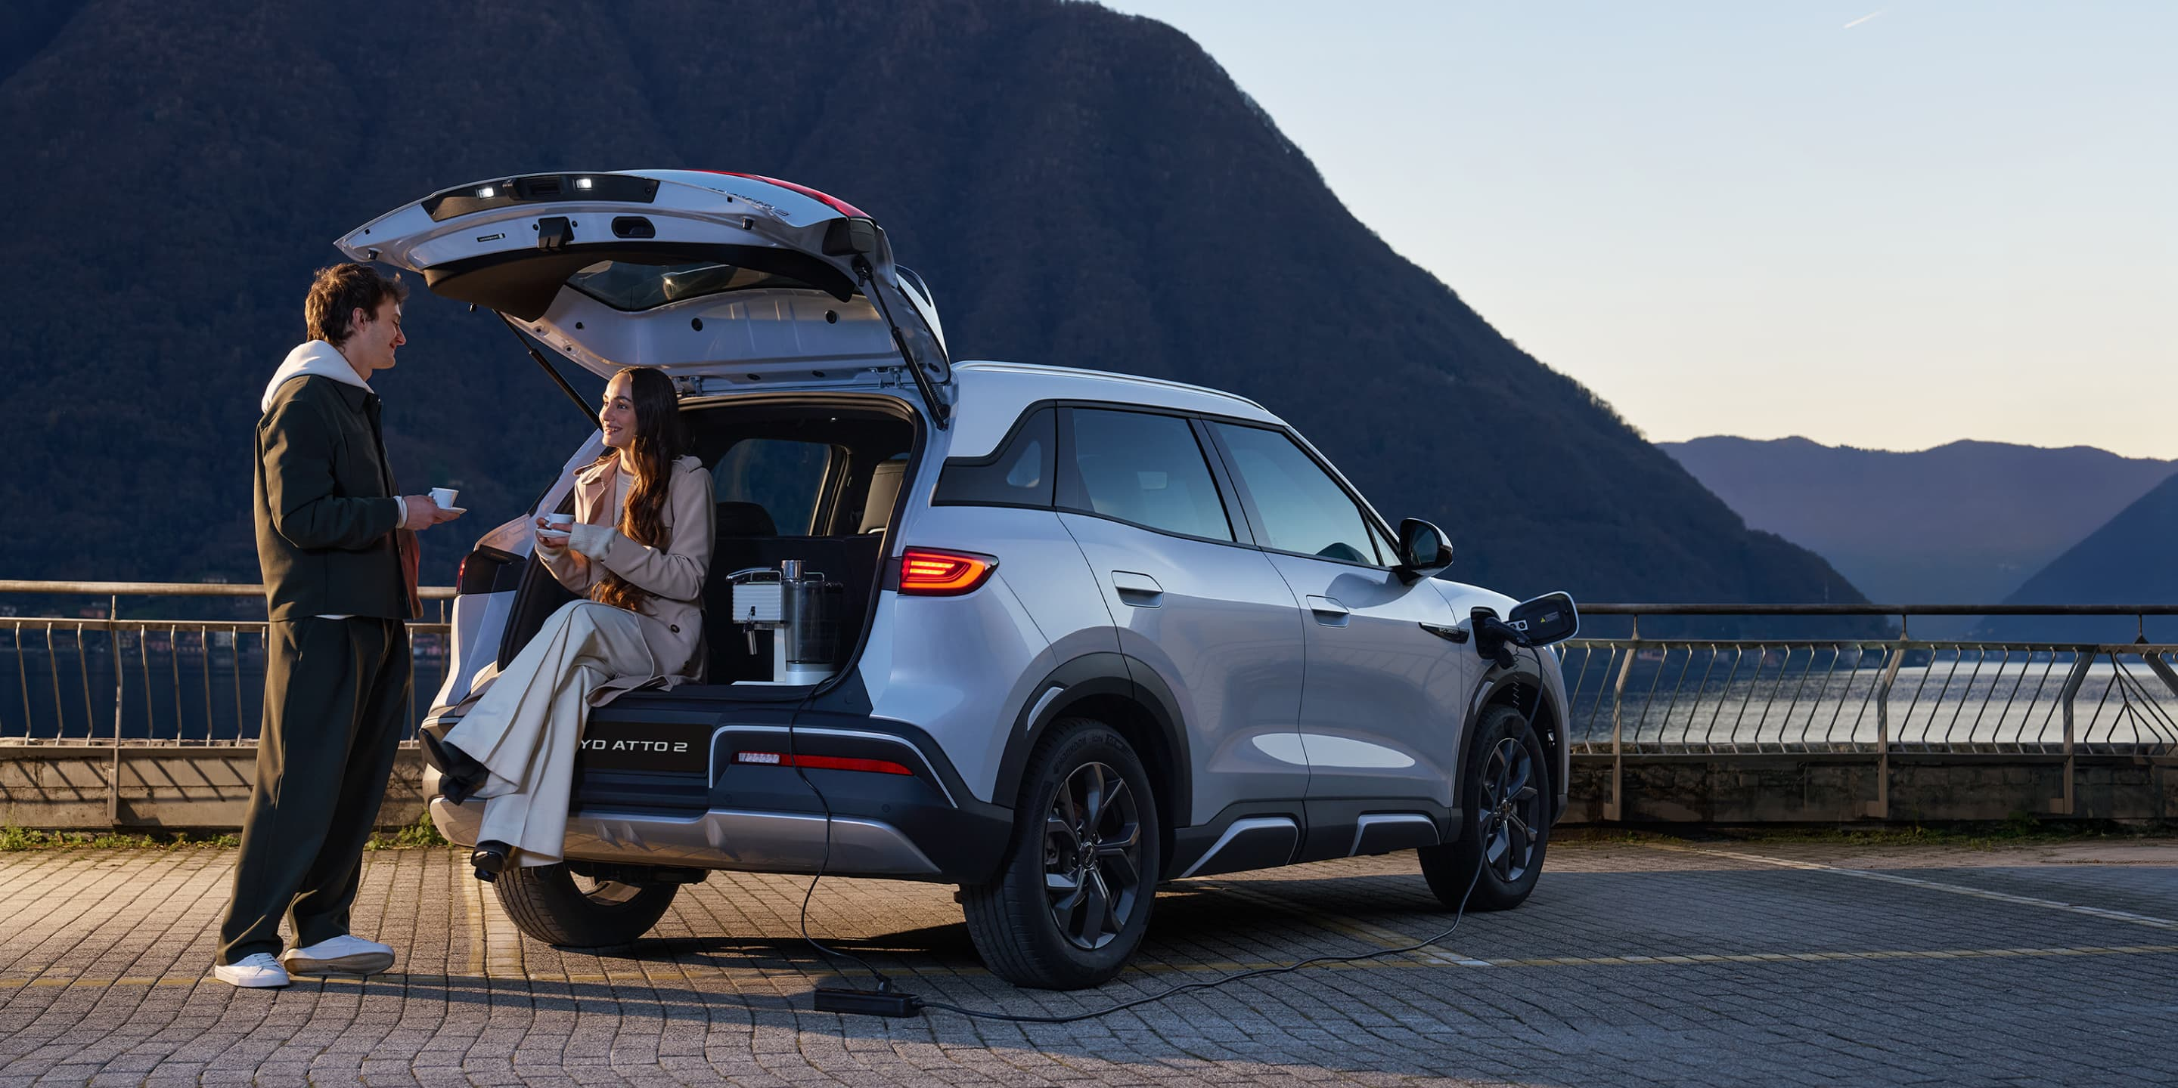
Control at your fingertips
With the convenience of NFC keyless entry, using a card or a phone, the BYD ATTO 2 is always ready to go. Plus you can prepare your journey in advance, in hot or cold conditions, by activating the air conditioning via remote control.
V2L Technology
Light up your life every day
Turn the BYD ATTO 2 into a mobile charging station with Vehicle-to-Load (V2L) functionality, enriching your outdoor activities by allowing you to plug in and use a variety of devices with ease. Power up devices like game consoles, power appliances to enjoy a cup of coffee, or charge your tech gadgets while on the go—perfect for picnics, camping, and more. The only limit is your imagination.

